Slide 1
15-7 Triple Integrals

Slide 2
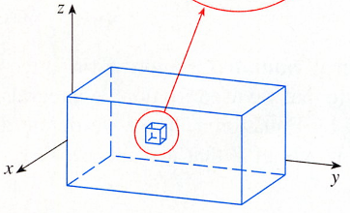


Just as we defined
single integrals
one variable
double integrals
for functions of
two variables
triple integrals
three variables
the simplest case
f is defined on a rectangular box:

Slide 3
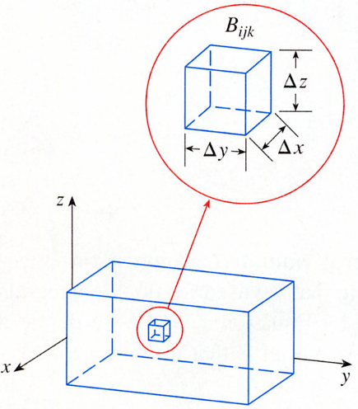
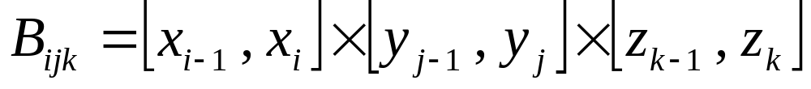
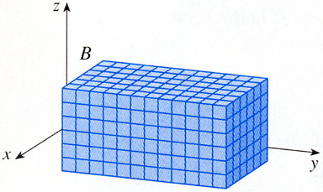
Divide B into sub-boxes
[a , b] into l subintervals [x_{i-1} , x_{i}] of equal width Δx
[c , d] into m subintervals of width Δy
[r , s] into n subintervals of width Δz
B_{ijk}
divide the box B into lmn sub-boxes
△z
△y
△x
△V =△x△y△z

Slide 4
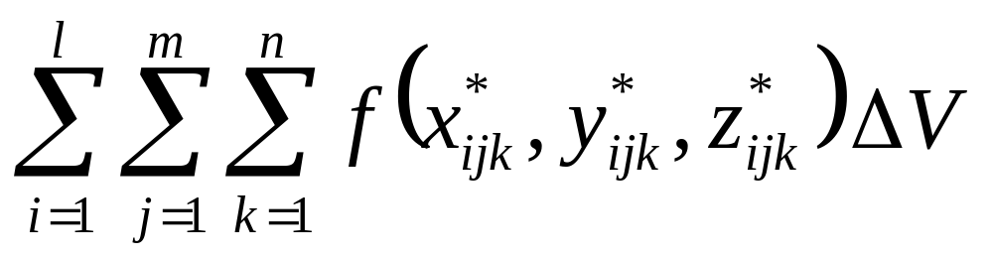

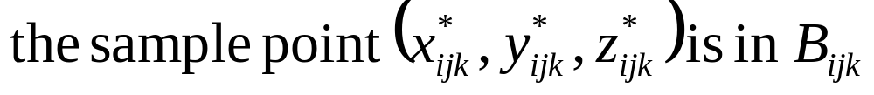

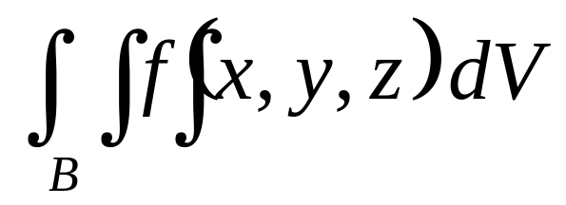
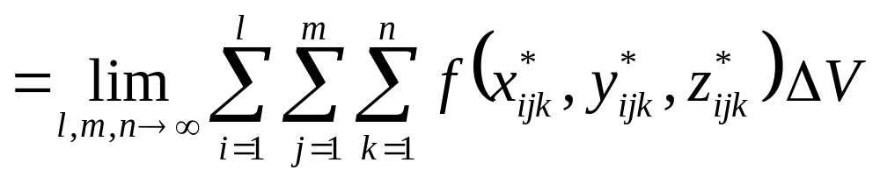
Then we form the triple Riemann sum
define the triple integral as the limit of the triple Riemann sums
Definition The triple integral of f over the box B is
if this limit exists.
if f is continuous
the triple integral exists

Slide 5
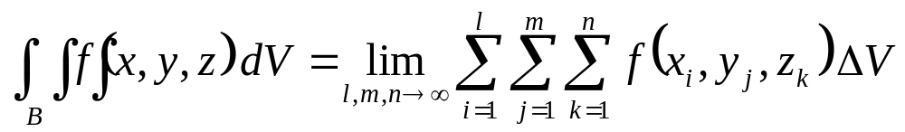

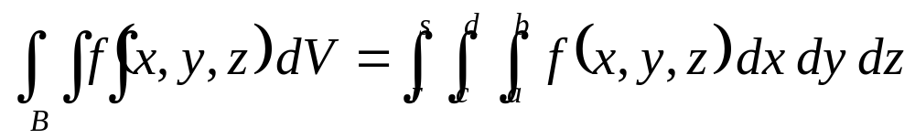
If we choose the point (x_{i} , y_{j} , z_{k})
get a simpler-looking expression for the triple integral :
Fubini’s Theorem for Triple Integrals
If f is continuous on the rectangular box

Slide 6
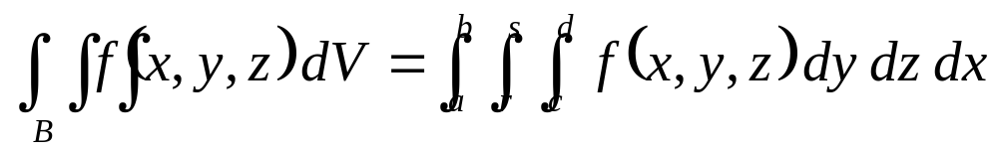
There are five other possible orders in which
we can integrate, all of which give the same value.
For instance,
respect to y , then z , and then x , we have

Slide 7
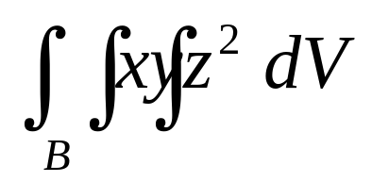
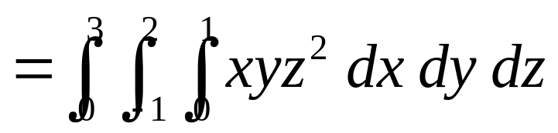
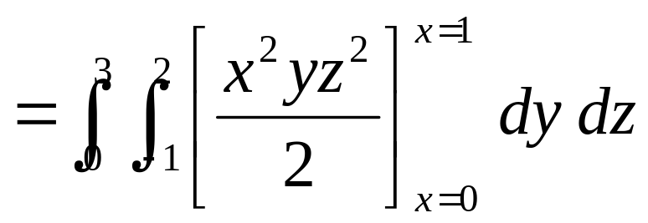
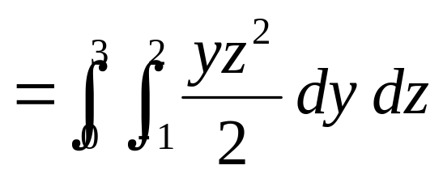
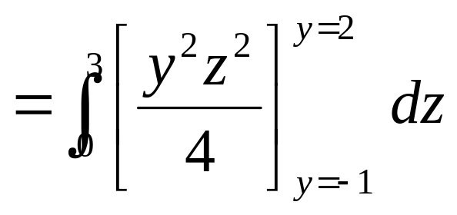
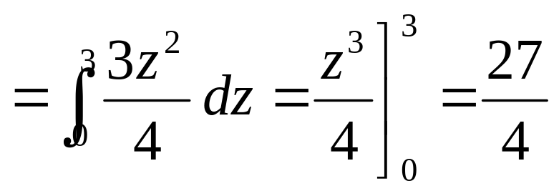

EXAMPLE 1
SOLUTION

Slide 8
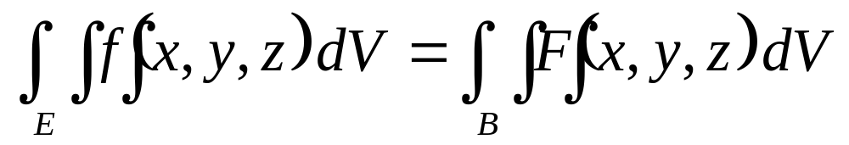
Now define the
triple integral over a general bounded region E
in three dimensional space (a solid)
enclose E in a box B
E_{f}
define a function F
B_{F}
agrees with f on E but is 0 for points in B that are outside E.
f is continuous and the boundary of E is “reasonably smooth”
integral exists

Slide 9
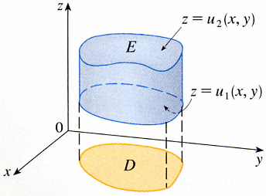

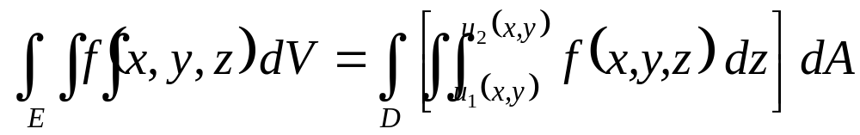
Type1
z =u₂(x, y)
E
upper boundary
D is the projection
z =u₁(x, y)
lower boundary
of E onto the xy-plane.
D
5
6
x and y are held fixed.
u₁(x,y) and u₂(x,y) are constants
f (x,y,z) is integrated with respect to z.

Slide 10
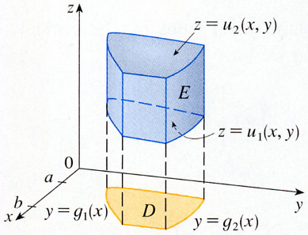

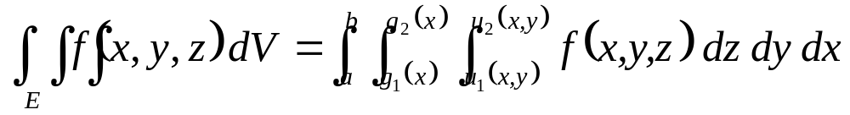
z =u₂(x, y)
In particular
E
z =u₁(x, y)
a
b
y =g₁(x)
D
y =g₂(x)

Slide 11
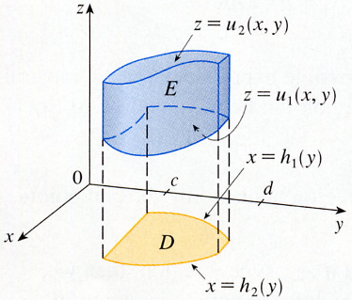

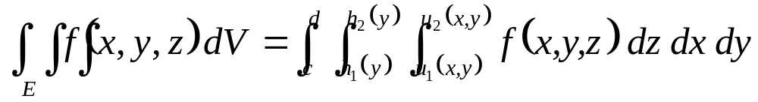
If, on the other hand,
z =u₂(x, y)
E
z =u₁(x, y)
x =h₁(y)
c
d
D
x =h₂(y)

Slide 12
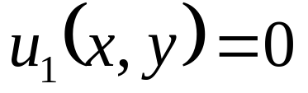
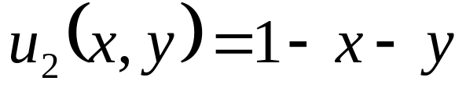
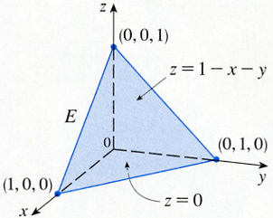
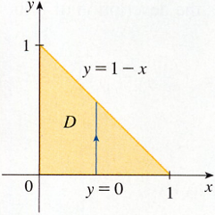
EXAMPLE 2
SOLUTION
Z
1
y
y = 0
z = 1- x- y
y= 1 - x
y = 1 - x
E
D
x
x = 0
y= 0
1
z = 0
x = 1

Slide 13
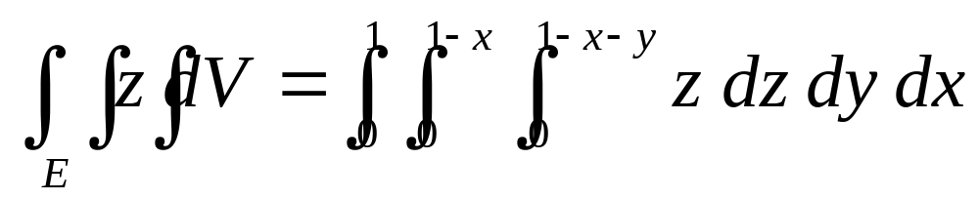
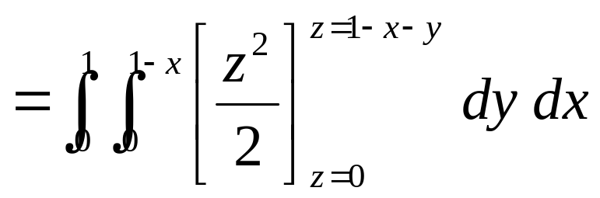
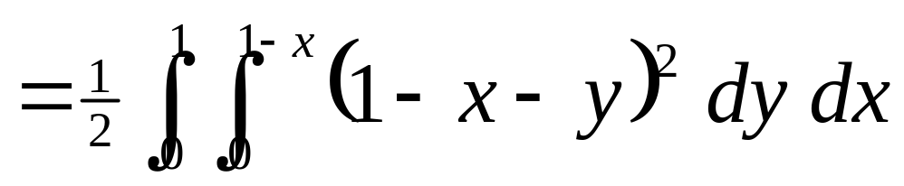
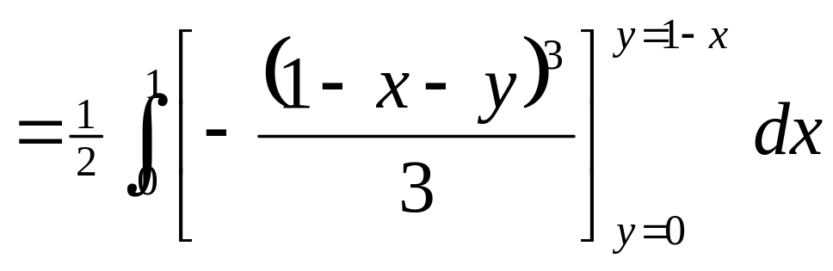
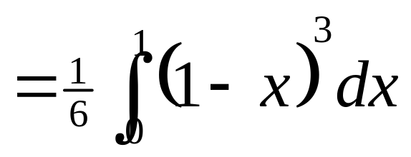
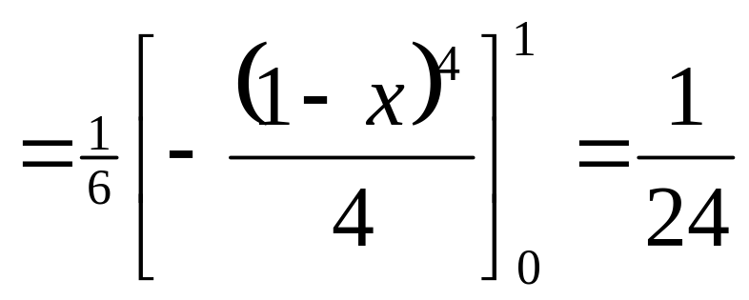

Slide 14
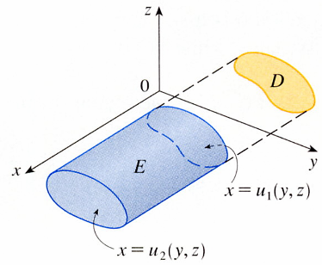

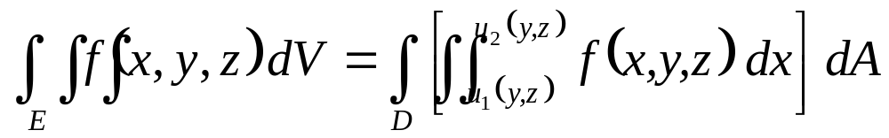

Type 2
D
E
x=u₁(y, z)
back surface
x=u₂(y, z)
front surface

Slide 15
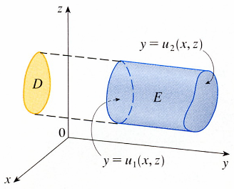



Type 3
y =u₂(x, z)
right surface
D
E
y =u₁(x, z)
left surface

Slide 16
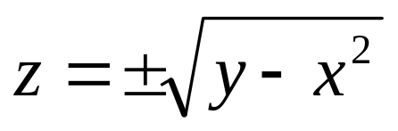
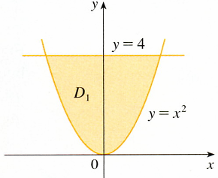
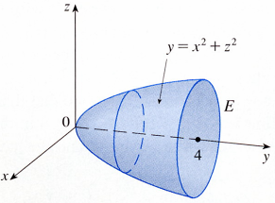
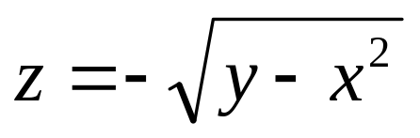
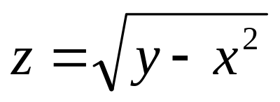
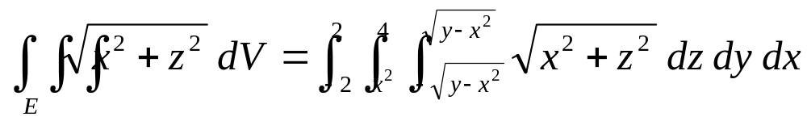
EXAMPLE 3
y=4
y= x²+z²
lower surface
D₁
0
E
y=x²
4
upper surface
Projection on XY- plane.
it is difficult to evaluate
instead consider E as a type 3 region.

Slide 17
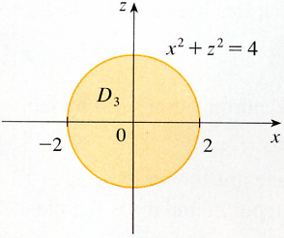
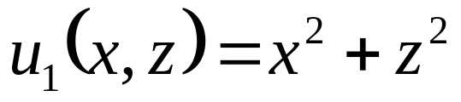
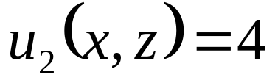
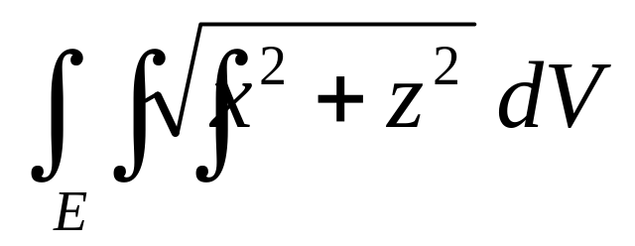
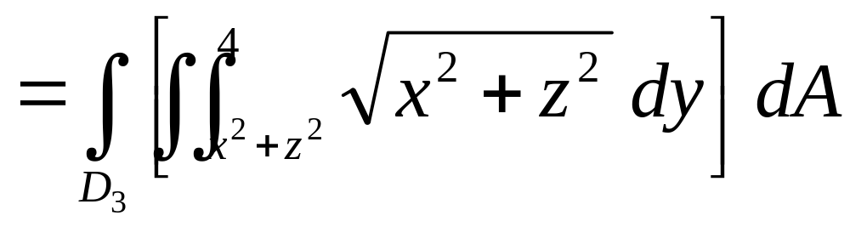
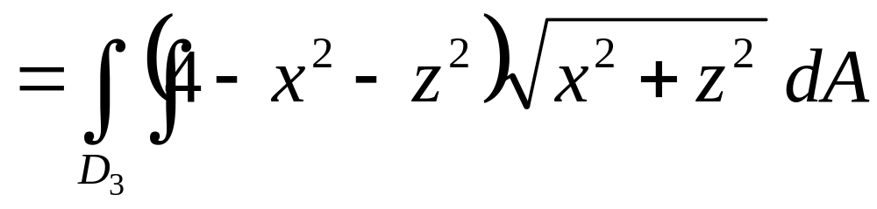
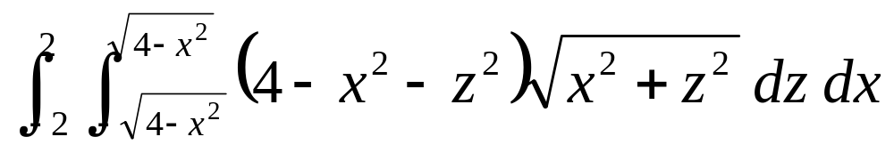
y
x²+z²=4
left boundary
y= x²+z²
D₃
0
E
- 2
2
right boundary
4
we regard it as a type 1 region.
Projection on xz-plane

Slide 18




convert to polar coordinates in the xz-plane:
Projection on xz-plane

Slide 19





Applications of Triple Integrals
be the “hypervolume” of a four-dimensional object and difficult to visualize

Slide 20






With the special case f (x , y , z)=1 for all points in E.
represents the volume lies between the surfaces

Slide 21








EXAMPLE 4
SOLUTION
(0,0,2)
x=2y
x+2y+z=2
T
0
(0,1,0)
(1,1/2,0)
1
x+2y=2
D
(1,1/2)
y=x/2
0
1
（四面體）

Slide 22






All the applications of double integrals can be
extended to triple integrals.
For example
the density function of a solid
object that occupies the region E is ρ(x , y , z)
at any given point (x , y , z), then its mass is
its moments about the three coordinate planes are

Slide 23









The center of mass is located at the point , where
If the density is constant,
the center of mass of the solid is called the centroid of E.
moments of inertia about the three coordinate axes are

Slide 24


the total electric charge on a solid object occupying a region E

Slide 25





EXAMPLE 5
SOLUTION
upper surfaces
x= y²
z= x
D
x=1
E
1
z= 0
lower surfaces
describe E as a type 2

Slide 26







Slide 27







Because of the symmetry of E and ρ about the xz-plane
z= x
E
1

Slide 28






the center of mass is

Slide 29
15-7 Exercises
EX9，EX37

